Slide 1


DS1108 - Web Programming I
H.M.C. Nirmani
Lecturer (Probationary)
Department of Software Engineering
Faculty of Computing
Sabaragamuwa University of Sri Lanka

Slide 2
Session 01
Internet Fundamentals

Slide 3

Outline
1
Network and Internet
2
How to connect to the Internet?
3
Internet addressing
4
Uniform Resource Locator
5
The Internet’s client/server architecture
6
Peer-To-Peer architecture
7
Internet Security & Privacy

Slide 4

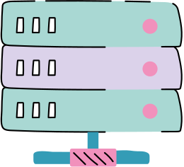
Intended Learning Outcomes
Upon the completion of this session the students should be able to:
Explain the importance of computer networks and the Internet in communication and resource sharing.
Identify different types of networks and Internet services.
Describe Internet architectures.
Discuss common Internet security and privacy issues with possible protection methods.

Slide 5
Network and Internet

Slide 6
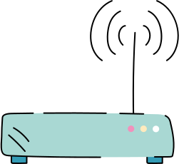
Computer network?
A computer network is a group of computers and other computing hardware devices that are linked together through communication channels to facilitate communication and resource sharing among a wide range of users.
Networks are used to:
Facilitate communication: They help people connect through email, video calls, and instant messaging.
Share hardware devices: Multiple users can use a single printer or scanner connected to the network.

Slide 7
Computer network?
Networks are used to:
Share files: Users can easily share data across the network.
Share software: Programs and software can be accessed and used on remote systems.
Access and maintain information: Networks make information more accessible and easier to manage for users.

Slide 8
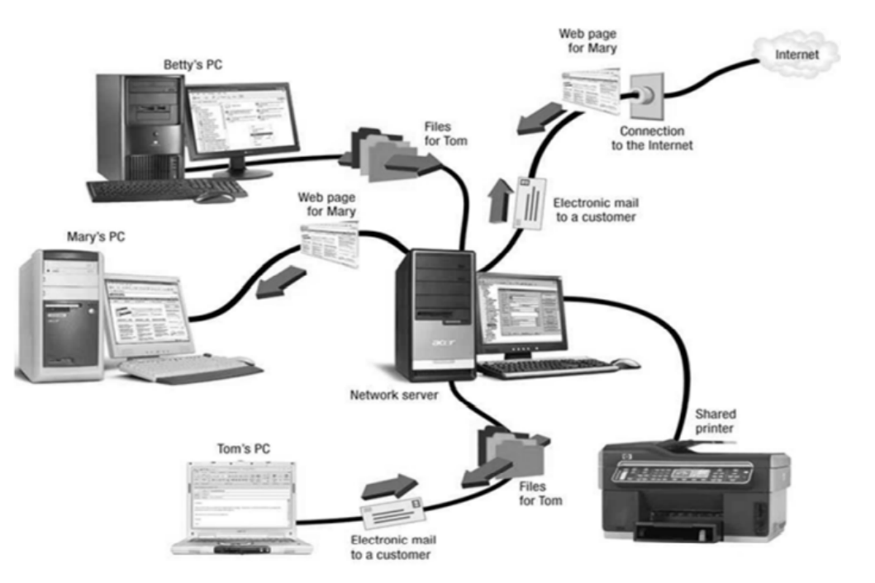
Computer network?
Example of Computer Network

Slide 9
Types of Networks
Networks
Intranet
Extranet
Internet

Slide 10
Types of Networks
Intranet
A private computer network.
Information is securely transferred among group of people.
Eg :- share organizational information among employees
Extranet
Same as Intranet.
But share part of internal information or operations with outsiders.
Eg :- share part of organizational information with vendors, suppliers etc.

Slide 11
The Internet
The internet is a network of network.
It is a global network of computers cooperating to exchange data through common software.
As a result; any computer on network can communicate with any other computer on any network.
This allow users to exchange messages, to communicate in real time, to share data and programs, and to access limitless stores of information.
It was conceived by the ARPA (Advanced Research Projects Agency in United States) in 1969 and was first known as the ARPANet.
Today, the internet is public, cooperative and self-sustaining facility accessible to hundreds of millions of people world wide.

Slide 12
The Internet
Uses of Internet:
On-line communication
Software sharing
Customer support service
On-line shopping
World wide video conferencing
Advantages of Internet:
Faster communication
Infinite education
Entertainment for everyone
Online services and E-commerce

Slide 13
The Internet
Disadvantages of Internet:
Theft of personal information
spamming
Malware threats
Age-inappropriate content
Social isolation, obesity and depression

Slide 14


Activity
Write a short description of at least five (5) different applications of the Internet.

Slide 15
How to connect to the Internet?

Slide 16
Internet Service Provider
Internet Service Provider (ISP) is a company that provides internet connections and services.
ISP connects to its customers using a data transmission technology appropriate for delivering Internet Protocol packets. (dial-up, DSL, cable modem, wireless etc.)
ISPs may provide services such as remotely storing data files on behalf of their customers, as well as other services unique to each particular ISP.
Virtual ISP - an operation which purchase services from another ISP
Free ISP - ISPs which provide service free of charge

Slide 17
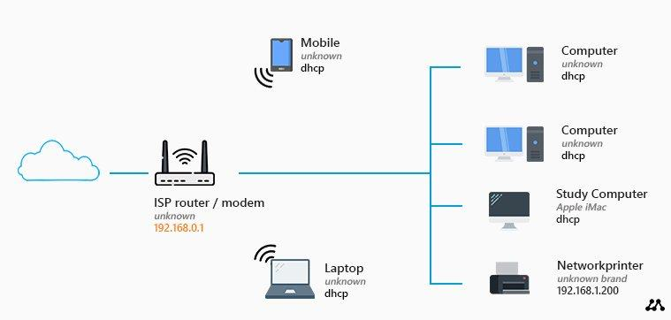
Internet Service Provider

Slide 18
Point of Presence (POP)
A Point of Presence (POP) is like a meeting point between different networks or devices where they connect to share information.
It’s where routers, switches and services are located to help data travel between networks.
A POP is a link between an ISPs network and a specific geographic area it serves.
ISPs often have multiple POPs to efficiently manage and distribute internet traffic.

Slide 19
Internet Addressing

Slide 20
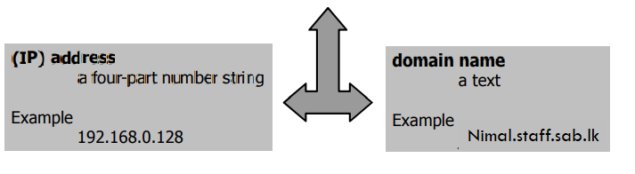
Internet Address
An Internet Address uniquely identifies a node on the internet.
Internet Address may also refer to the name or IP of a web site.

Slide 21
IP Address (Internet Protocol Address)
An IP Address (IPv4) is a unique number for each device on a network, like 216.27.61.137
A unique numeric identifier, divided in to four octets separated by periods, assigned to machines on the internet or an intranet.

Slide 22
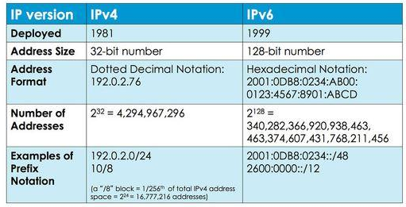
IPV (IP Versions)

Slide 23

Domain Names
A Domain Name is a human friendly identifier for a computer on the Internet, making it easier to remember than numeric IP address.
It is not an IP address itself. When we enter a domain name in a web browser, it’s translated in to the corresponding IP address to locate the desired server on the internet.
Translating the domain name in to the IP address is called “resolving the domain name” or “DNS resolution”.

Slide 24
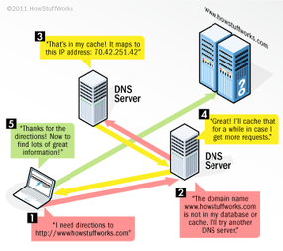
How DNS resolution Work?

Slide 25
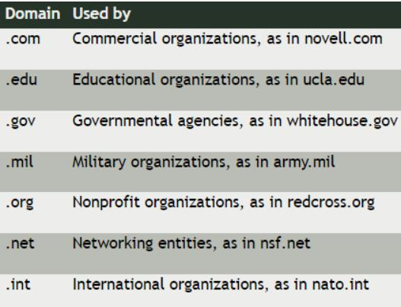
Domain Name Server (DNS)
DNS is a hierarchical naming system built on a distributed database for computers, services or any resource connected to the Internet or a private network.
DNS Hierarchy

Slide 26
Uniform Resource Locator

Slide 27
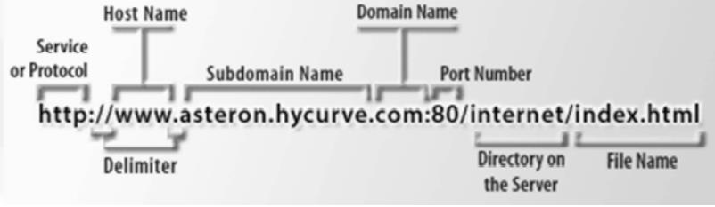
Uniform Resource Locator (URL)
URL is the global address of documents and other resources on the World Wide Web.
Example:

Slide 28
The Internet’s client/server architecture

Slide 29
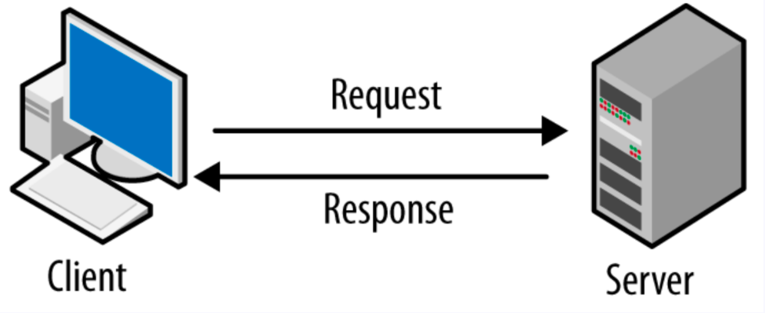
Client / Server Architecture
Client / Server Architecture is a model where clients seek services from servers in a networked environment, facilitating efficient resource sharing.
Client: service requesters that request the services from servers.
Server: service providers that provide services to other programs or machines.

Slide 30
Peer-To-Peer (P2P) Architecture

Slide 31
P2P Architecture
Peer-To-Peer (P2P) Architecture is a network where computers have equal capabilities and responsibilities.
P2P can share file directly, allowing quick and cost-effective file access over large distances.
Files can be accessed any time.
Unlike client/server architecture, there’s no dedicated distinction between serving and accessing computers.

Slide 32
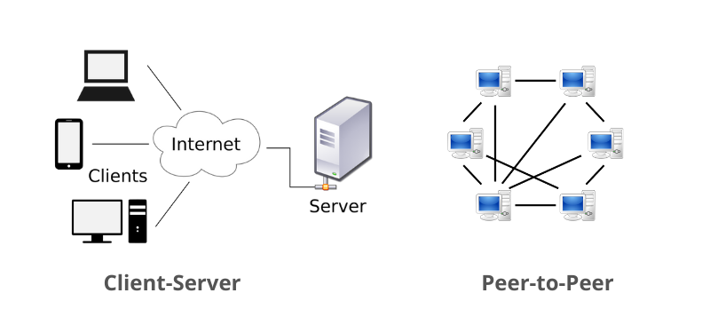
P2P Architecture

Slide 33
Internet Security & Privacy

Slide 34
Internet Security
Activity
When a computer connected to a network, what types of damages could be occurred? Explain each briefly.
What are the methods to protect the information in network? Explain each briefly.

Slide 35


Thank You

